Slide 1
YEAR 6

Slide 2
Complete the following calculation:
12
2544 ÷ 12
Go onto the next slide to see the division process for this calculation.

Slide 3
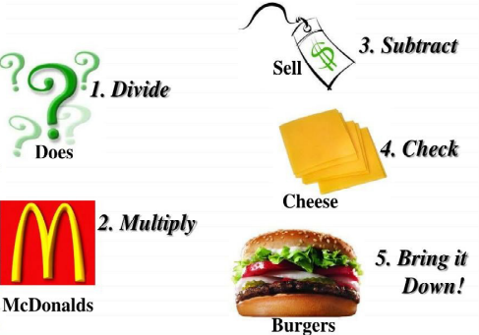
2
1
2
D÷
M×
S–
B
R
12
4
12
2
5
4
4
4
24
1
12
2
24
Write 2 above the 4 and there is your final answer!
How many 12s are there in 24?
Now drop down the 4.
What is 14 minus 12?
Write 1 above the 4 and 12 below the 14.
How many 12s are there in 14?
Now drop down the 4.
What is 25 minus 24?
Write 2 above the 5 and write 24 below the 25.
How many 12s are there in 25?
Let’s start by dividing 25 by 12 as they are both a 2 digit number.

Slide 4
Complete the following calculation:
12
7397 ÷ 13
Go onto the next slide to see the division process for this calculation.

Slide 5
5
6
9
D÷
M×
S–
B
R
12
7
13
7
3
9
9
7
65
8
78
11
117
Let’s start by dividing 73 by 13 as they are both a 2 digit number.
Write 9 above the 7 and there is your final answer!
How many 13s are there in 117?
Now drop down the 7.
What is 89 minus 78?
Write 6 above the 9 and 78 below the 89.
How many 13s are there in 89?
Now drop down the 9.
What is 73 minus 65?
Write 5 above the 3 and write 65 below the 73.
How many 13s are there in 73?

Slide 6
Complete the following calculation:
12
4712 ÷ 31
Go onto the next slide to see the division process for this calculation.

Slide 7
1
5
2
D÷
M×
S–
B
R
12
1
2
31
4
7
1
2
31
16
155
6
62
Write 2 above the 2 and there is your final answer!
Now drop down the 1.
What is 47 minus 31?
Let’s start by dividing 47 by 31 as they are both a 2 digit number.
How many 31s are there in 161?
Write 1 above the 7 and write 31 below the 47.
How many 31s are there in 62?
Write 5 above the 1 and 155 below the 161.
Now drop down the 2.
How many 31s are there in 47?
What is 161 minus 155?

Slide 8
Complete the following calculation:
12
4005 ÷ 89
Go onto the next slide to see the division process for this calculation.

Slide 9
0
4
5
D÷
M×
S–
B
R
12
5
89
4
0
0
5
0
0
40
356
44
445
Write 5 above the 5 and there is your final answer!
How many 89s are there in 445?
Now drop down the 5.
What is 400 minus 356?
Write 4 above the 0 and 356 below the 400.
How many 89s are there in 400?
Now drop down the 0.
What is 40 minus 0?
Write 0 above the 0 and write 0 below the 40.
How many 89s are there in 40?
Let’s start by dividing 40 by 89 as they are both a 2 digit number.

